Slide 1

Software Engineering
Introduction to Software Engineering
Department of Computer Science and Engineering
Acknowledgement: Authors of the prescribed textbooks and materials sourced online.

Slide 2
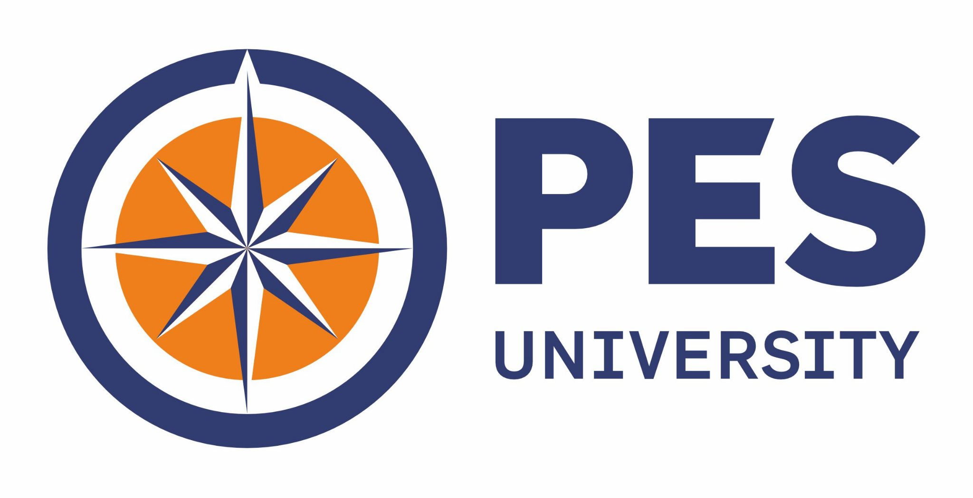
Software Engineering
Legacy SDLCs — Waterfall, V, Prototype, Incremental & Iterative Models
Department of Computer Science and Engineering

Slide 3
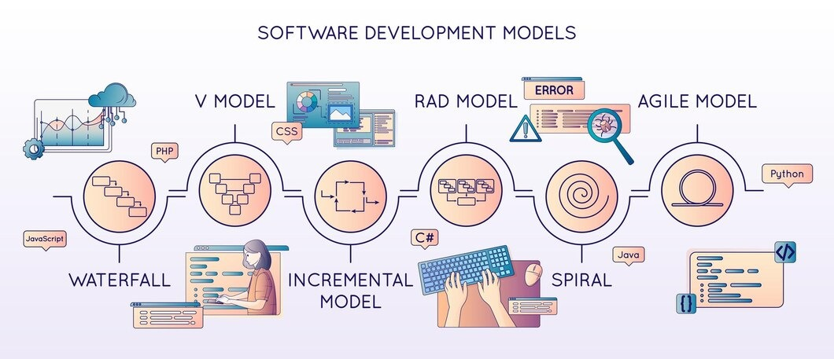

Slide 4
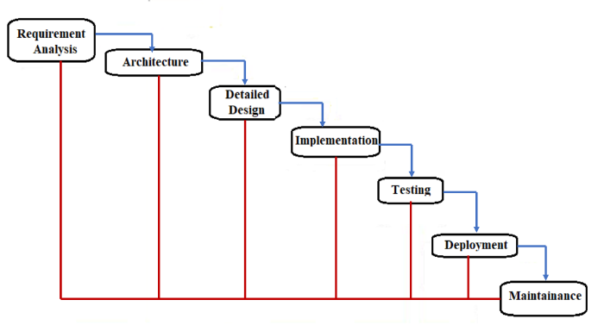
Waterfall Model
A classic model that was introduced in 1970 — it offers a linear approach where each phase strictly follows one another.
Simplest of all, but lacks flexibility.
Once you move from one phase to the next, it’s challenging to go back and make changes. This rigidity makes it unsuitable for evolving projects.

Slide 5
Waterfall Model – Advantages, Disadvantages & Usage
ADVANTAGES | DISADVANTAGES
Simple | Assumes requirements are frozen
Clear identified phases | Difficult to change & sequential
Easy to manage due to rigidity | Poor model for long projects
Each phase – specific deliverables + reviews | Big Bang approach
Easy to departmentalize and control | High risk + Uncertainty
Pure form: Short projects where requirements are well known
Product definition is stable & technology is understood
Variant form: High level in long projects. Also used in large globally developed projects with other lifecycle models
USAGE

Slide 6
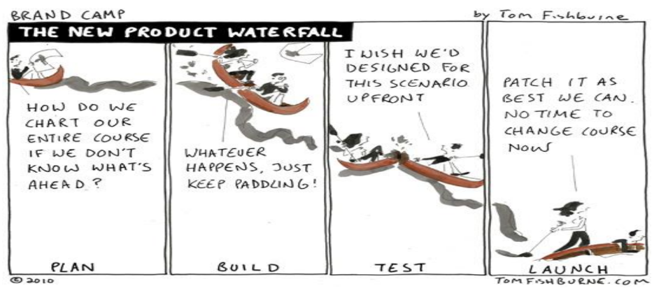
Waterfall Model — Comic

Slide 7
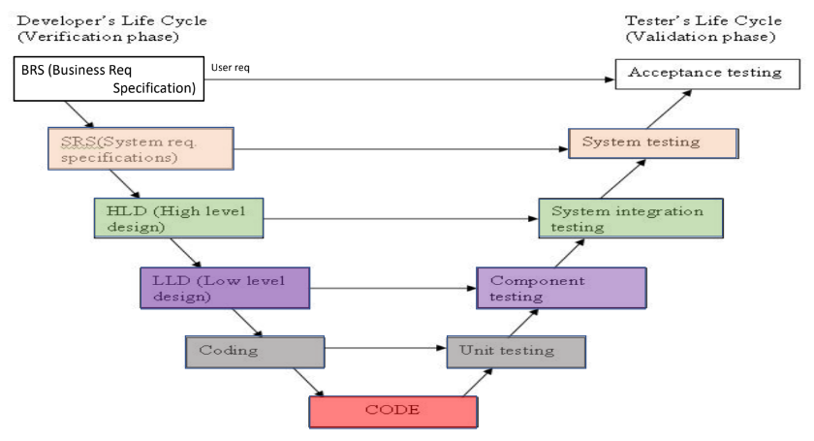
V Model

Slide 8
V Model – Advantages, Disadvantages & Usage
A sequential software development model (Verification & Validation model). It extends the principles of the Waterfall model and incorporates the testing phase for each development stage. This model is best used where the requirements are stable, the project is short, and everyone understands how the technology is used.
ADVANTAGES | DISADVANTAGES
Similar to Waterfall model | Similar to Waterfall model
Test development activities like test design and static testing can happen before coding and the formal testing lifecycle | Software is developed during the implementation phase, so no early prototypes of the software are produced.
Higher probability of success + Increased effectiveness of usage of resources | Change through the process, necessitates changes in test documentation too.
USAGE:
Similar to Waterfall model

Slide 9
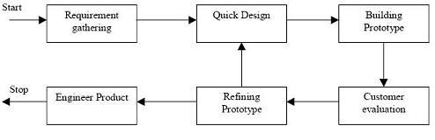
Prototype Model
Prototyping should be a relatively a cheap process — The prototype model requires that before carrying out the development of actual software, a working prototype of the system should be built.
Instead of freezing the requirements before a design or coding can proceed, a complete system prototype (with no or very less details) is built and to understand the requirements
Types are : Throw-away and evolutionary prototypes

Slide 10
Prototype Model – Advantages, Disadvantages & Usage
ADVANTAGES | DISADVANTAGES
Active involvement of users | May increase complexity of system as scope of system may expand beyond original plans
Better risk mitigation, Reduced time and cost, Resulting system is full featured, More stable system | Performance of resulting system may not be optimal
USAGE:
When requirements are not clear
Users are actively involved
Source: https://www.javatpoint.com/software-engineering-prototype-model

Slide 11
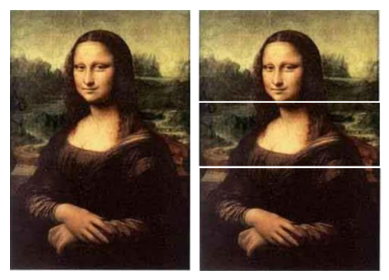
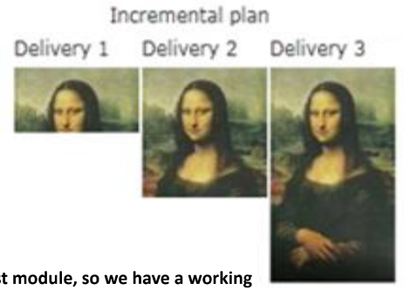
Incremental Model
Requirements are partitioned
Working version of software is produced during the first module, so we have a working software early on in the software life cycle.
Each subsequent release adds functionality to previous module
Continuous integration is done until entire system is achieved

Slide 12
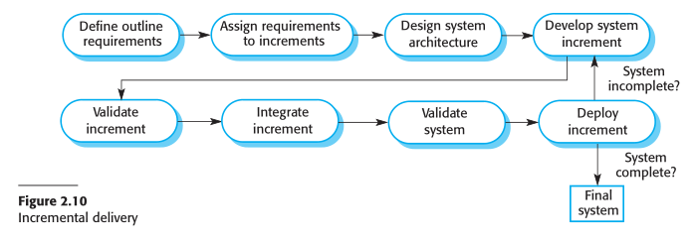
Incremental Model
Partitioned requirements can have a development lifecycle
Models like Waterfall, V, etc. can be used for each partition
Leveraged prototype for additional features would be a form of incremental model
FUN FACT
A methodology that can be used to build large and complex systems by iteratively adding new features based on the analysis of source data.
Based on the idea of adding new features, or "increments" to an existing system instead of building the entire thing from scratch at once.

Slide 13
Incremental Model – Advantage, Disadvantage & Usage
ADVANTAGES | DISADVANTAGES
Customer value and more flexible | Needs good planning and design
Easier to test and debug | Needs clear and complete definition of whole system
Easier to manage risk | Total cost is higher than waterfall
Continuous increments rather than monolithic | Hard to identify common functionalities across increments
Reduces over functionality | Management visibility is reduced
Major requirements are defined
USAGE
High risk features and goals
Product needs to get to market early
Resources with required skill set unavailable
New technology is used

Slide 14
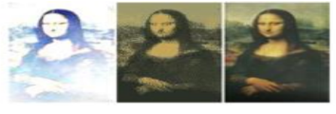
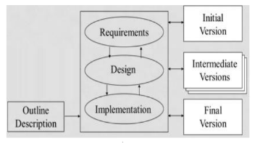
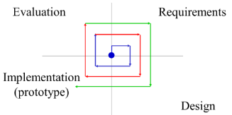
Iterative Model (Evolutionary)
Initial implementation starts from a skeleton of product
This is followed by refinement through user feedback & evolution
Built with dummy modules
Rapid prototyping
Successive refinement

Slide 15
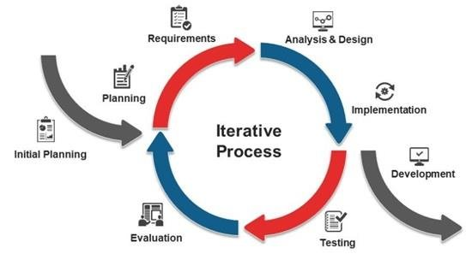
Iterative Model – Advantages, Disadvantages & Usage
ADVANTAGES | DISADVANTAGES
Help identify requirement & solution visualization | Each phase is rigid with overlaps
Support risk mitigation, rework is reduced, incremental investment, increased customer engagement | Costly system architecture may arise
USAGE: Large projects which may get extended

Slide 16
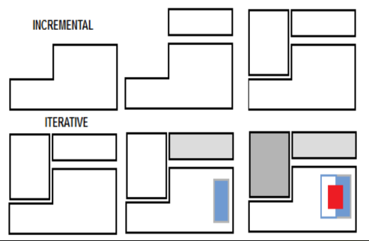
Comparison: Iterative vs Incremental Model
ITERATIVE MODEL | INCREMENTAL MODEL
Revisit and refine everything | No need to go back and change delivered things
Focus on details of things | Focus on things not implemented yet
Leverage on learnings | Does not leverage on experience or knowledge

Slide 17
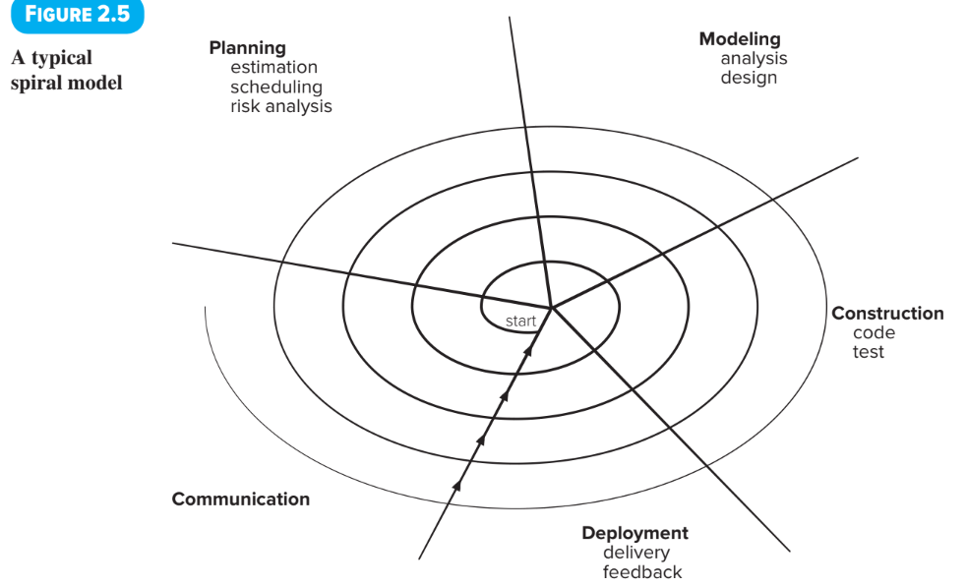
Spiral Model
An evolutionary process model that couples the iterative nature of prototyping with the systematic aspects of the waterfall model.
It uses prototyping as a risk reduction mechanism.
Each loop of the spiral is called a phase of the software development process and the number of loops in the spiral can vary depending on the project.

Slide 18
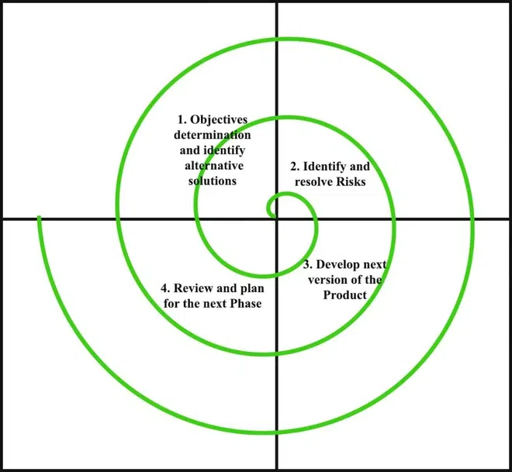
Spiral Model
The Radius of the spiral at any point represents the expenses (cost) of the project so far, and the angular dimension represents the progress made so far in the current phase.
Also called Meta-Model because it subsumes all the other SDLC models. Egs: a single loop spiral actually represents the Iterative Waterfall Model.
Source: https://www.geeksforgeeks.org/software-engineering-spiral-model/

Slide 19
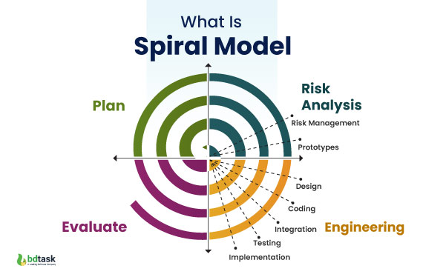
Spiral Model
USAGE: Complex and large projects, as it allows for a more flexible and adaptable approach. Well-suited to projects with uncertainty or high levels of risk.
ADVANTAGES | DISADVANTAGES
Emphasis on risk handling and management | Much more complex and expensive, compared to other SDLC models
Combines both iterative and incremental approaches to provide optimal process flow | As the number of phases is unknown at the start of the project, time estimation is very difficult.

Slide 20
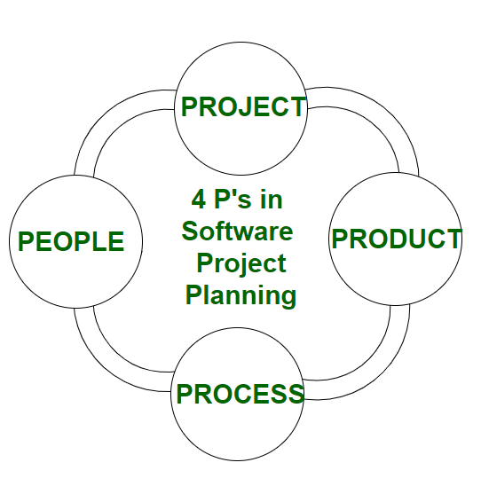
4Ps — Process, Product, Project & People
The 4Ps framework has been applied to various domains, including marketing and software project planning and supply chain.
> People: The most important component of a product and its successful implementation is human resources.
> Product: The deliverable or the result of the project.
> Process: Clearly defined process with several phases
regulates the development workflow.
> Project: Also considered as a blueprint of process.
Project manager plays a critical role, responsible to
guide the team members to achieve the targets.
Source: https://www.geeksforgeeks.org/4-ps-in-software-project-planning/

Slide 21
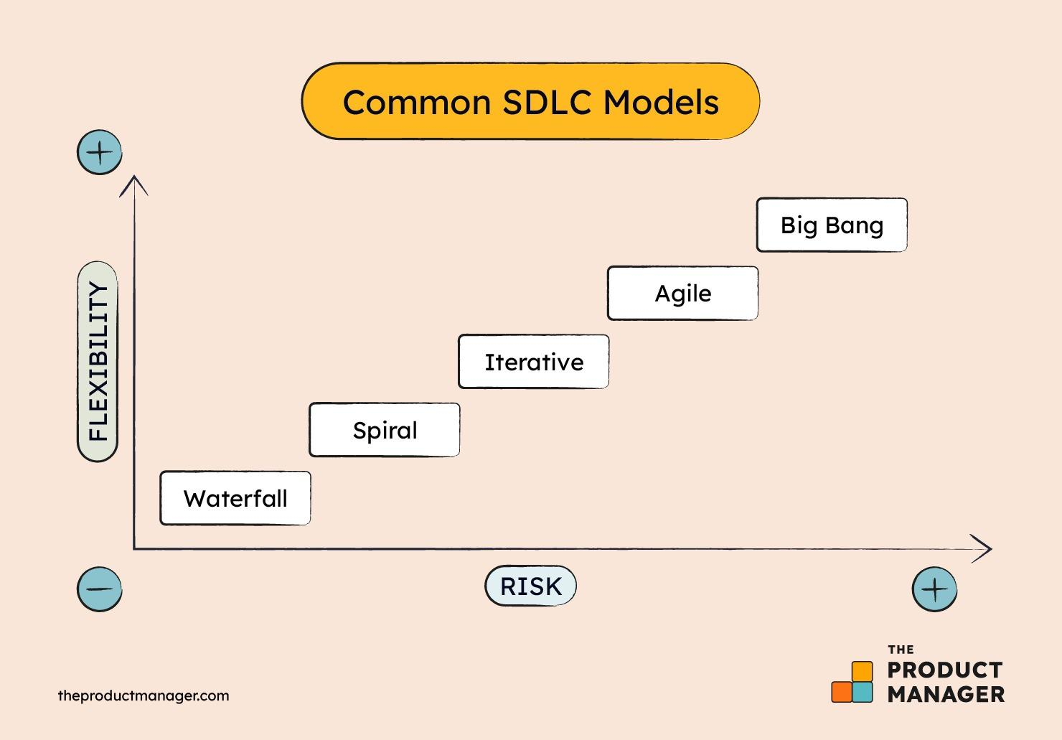
Comparison — Flexibility vs. Risk

Slide 22
THANK YOU

